Slide 1
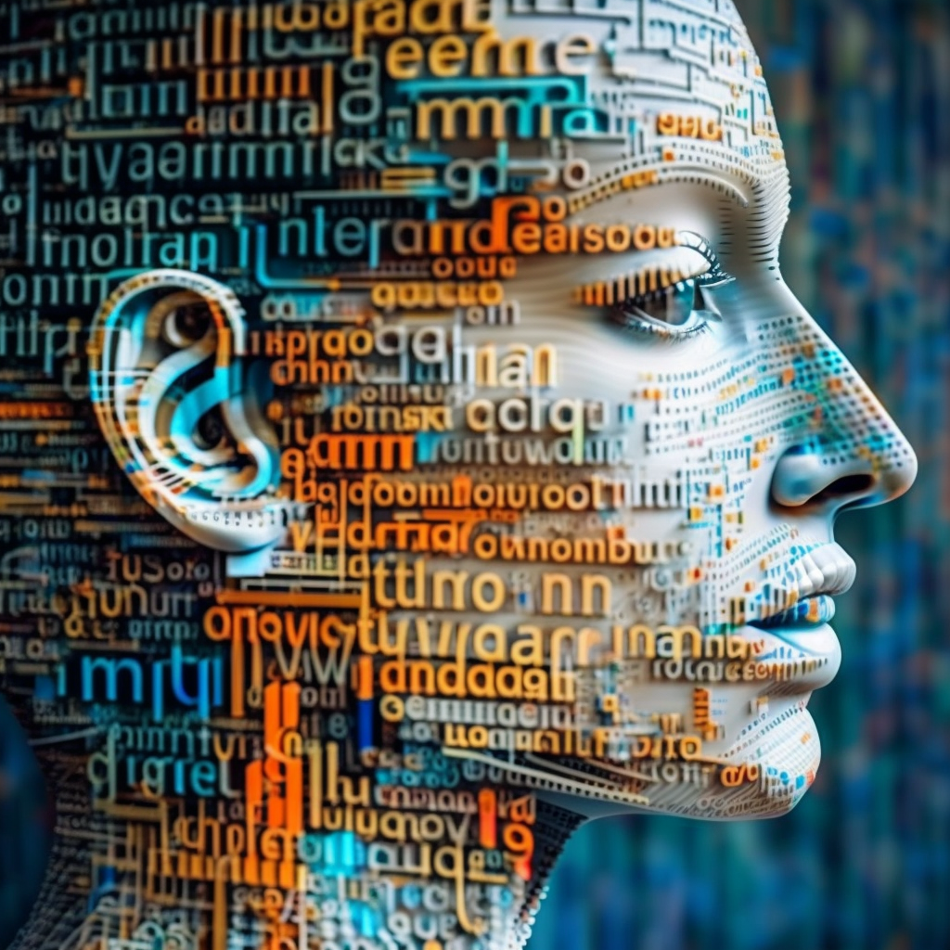
sequence modeling
midjourney bot (2023)

Slide 2
sequence modeling
Where does the ball go next?
Notes:
Also convex!

Slide 3
sequence modeling
Where does the ball go next?
??
Notes:
Also convex!

Slide 4
sequence modeling
Where does the ball go next?
Notes:
Also convex!

Slide 5
sequence modeling
Where does the ball go next?
Notes:
Also convex!

Slide 6
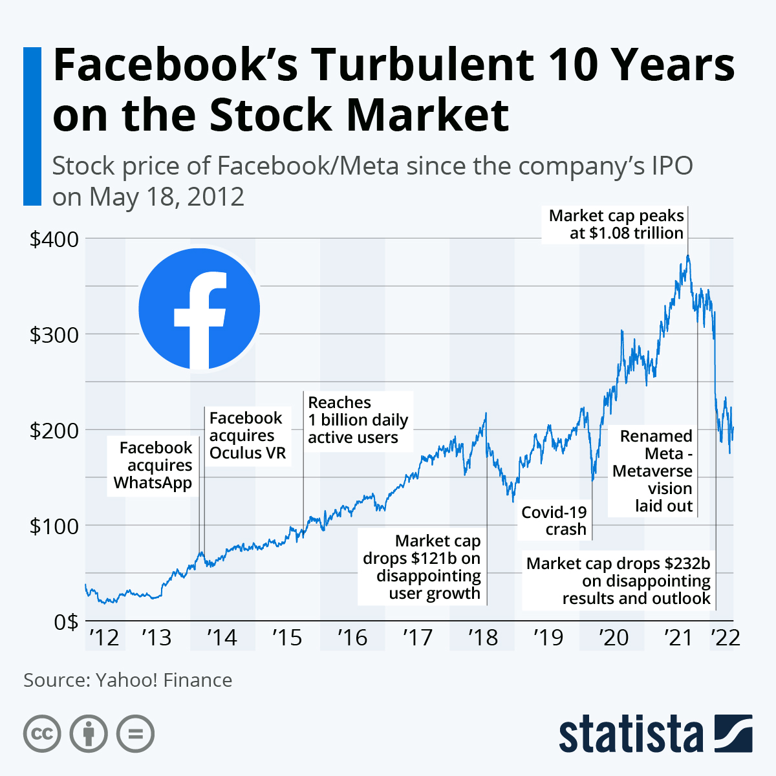
sequence modeling
text
video streams
audio streams
genomics, transcriptomics, proteomics
stock markets
weather, climate
electrocardiogram
…
Notes:
Also convex!

Slide 7
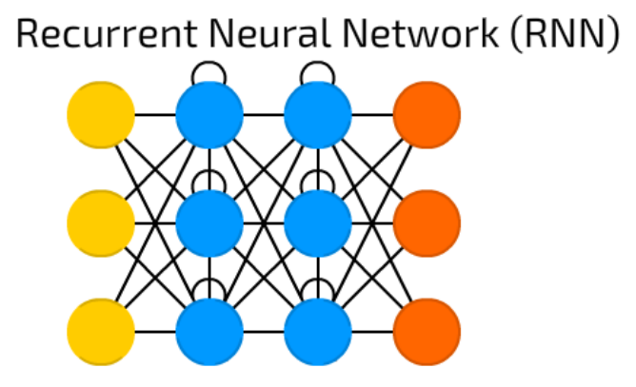
sequence modeling
Sequences can have variable length, which makes it hard to represent them as fixed length feature vectors.
The recurrent neural network module is designed to tackle this issue.
Notes:
Also convex!

Slide 8
sequence modeling
sentiment classification
protein function prediction
stock market price prediction
gene expression prediction
video topic classification
…
one to one many to one
Notes:
Also convex!

Slide 9

sequence modeling
A classroom with students discussing the future of AI in healthcare, photorealistic.
one to one many to one
Notes:
Also convex!

Slide 10
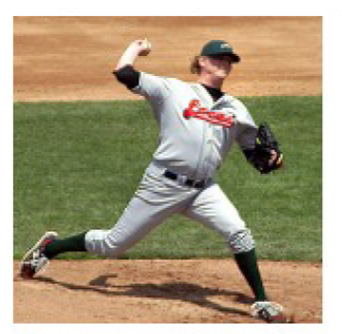
sequence modeling
A baseball player throwing a ball.
one to one one to many
Notes:
Also convex!

Slide 11
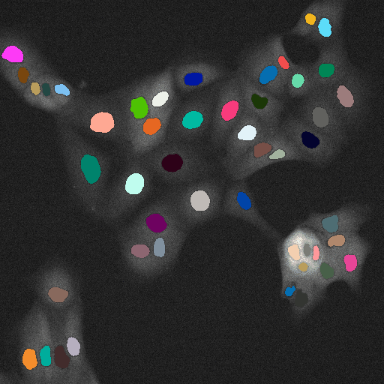
sequence modeling
one to one many to many
Notes:
Also convex!

Slide 12
sequence modeling
text translation
protein secondary structure prediction
MS/MS spectrum prediction
peptide identification
…
one to one many to many
Notes:
Also convex!

Slide 13
sequence modeling
text translation
protein secondary structure prediction
MS/MS spectrum prediction
peptide identification
…
one to one many to many
encoder
decoder
Notes:
Also convex!

Slide 14
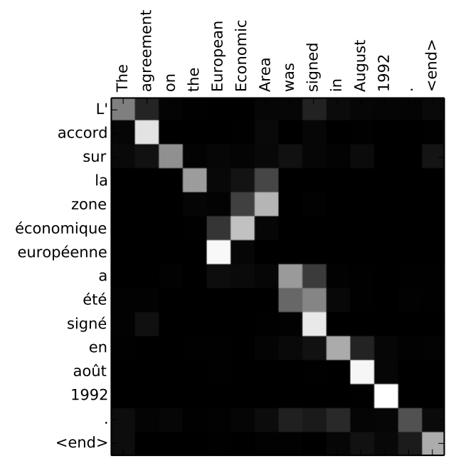
learning to pay attention: transformers
Notes:
You can see how the model paid attention correctly when outputing "European Economic Area". In French, the order of these words is reversed ("européenne économique zone") as compared to English. Every other word in the sentence is in similar order.

Slide 15
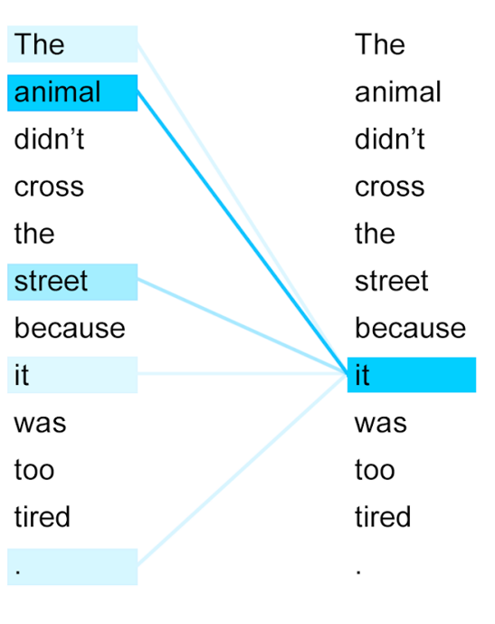
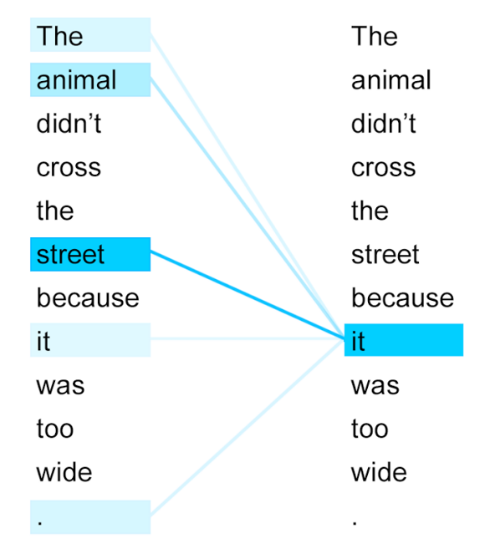
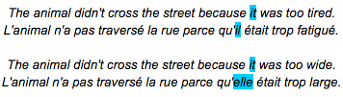
learning to pay attention: transformers

Slide 16
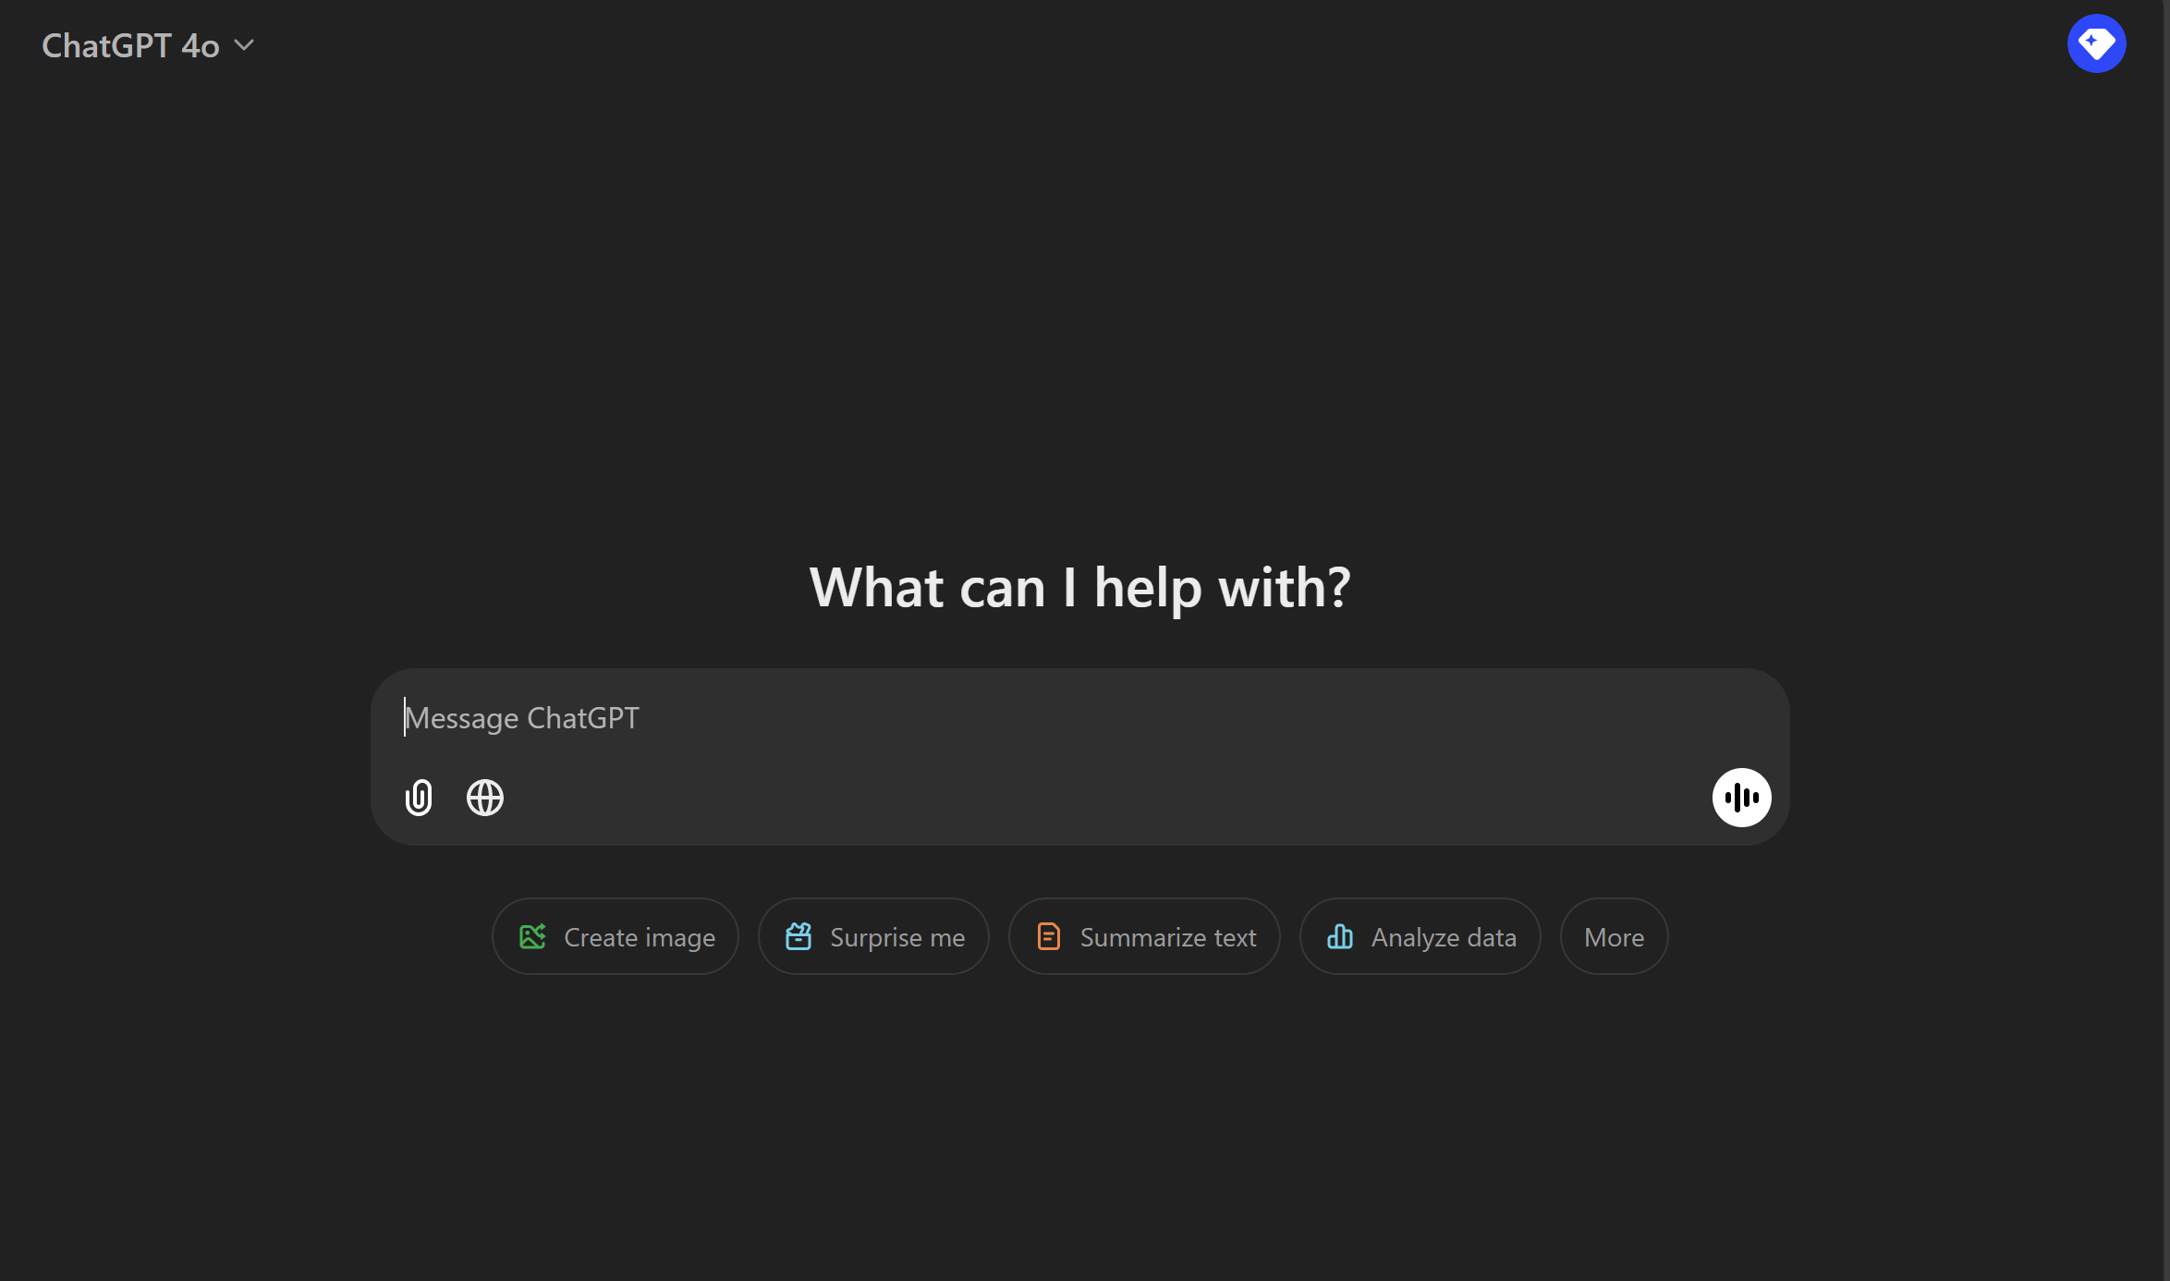
https://chatgpt.com/

Slide 17
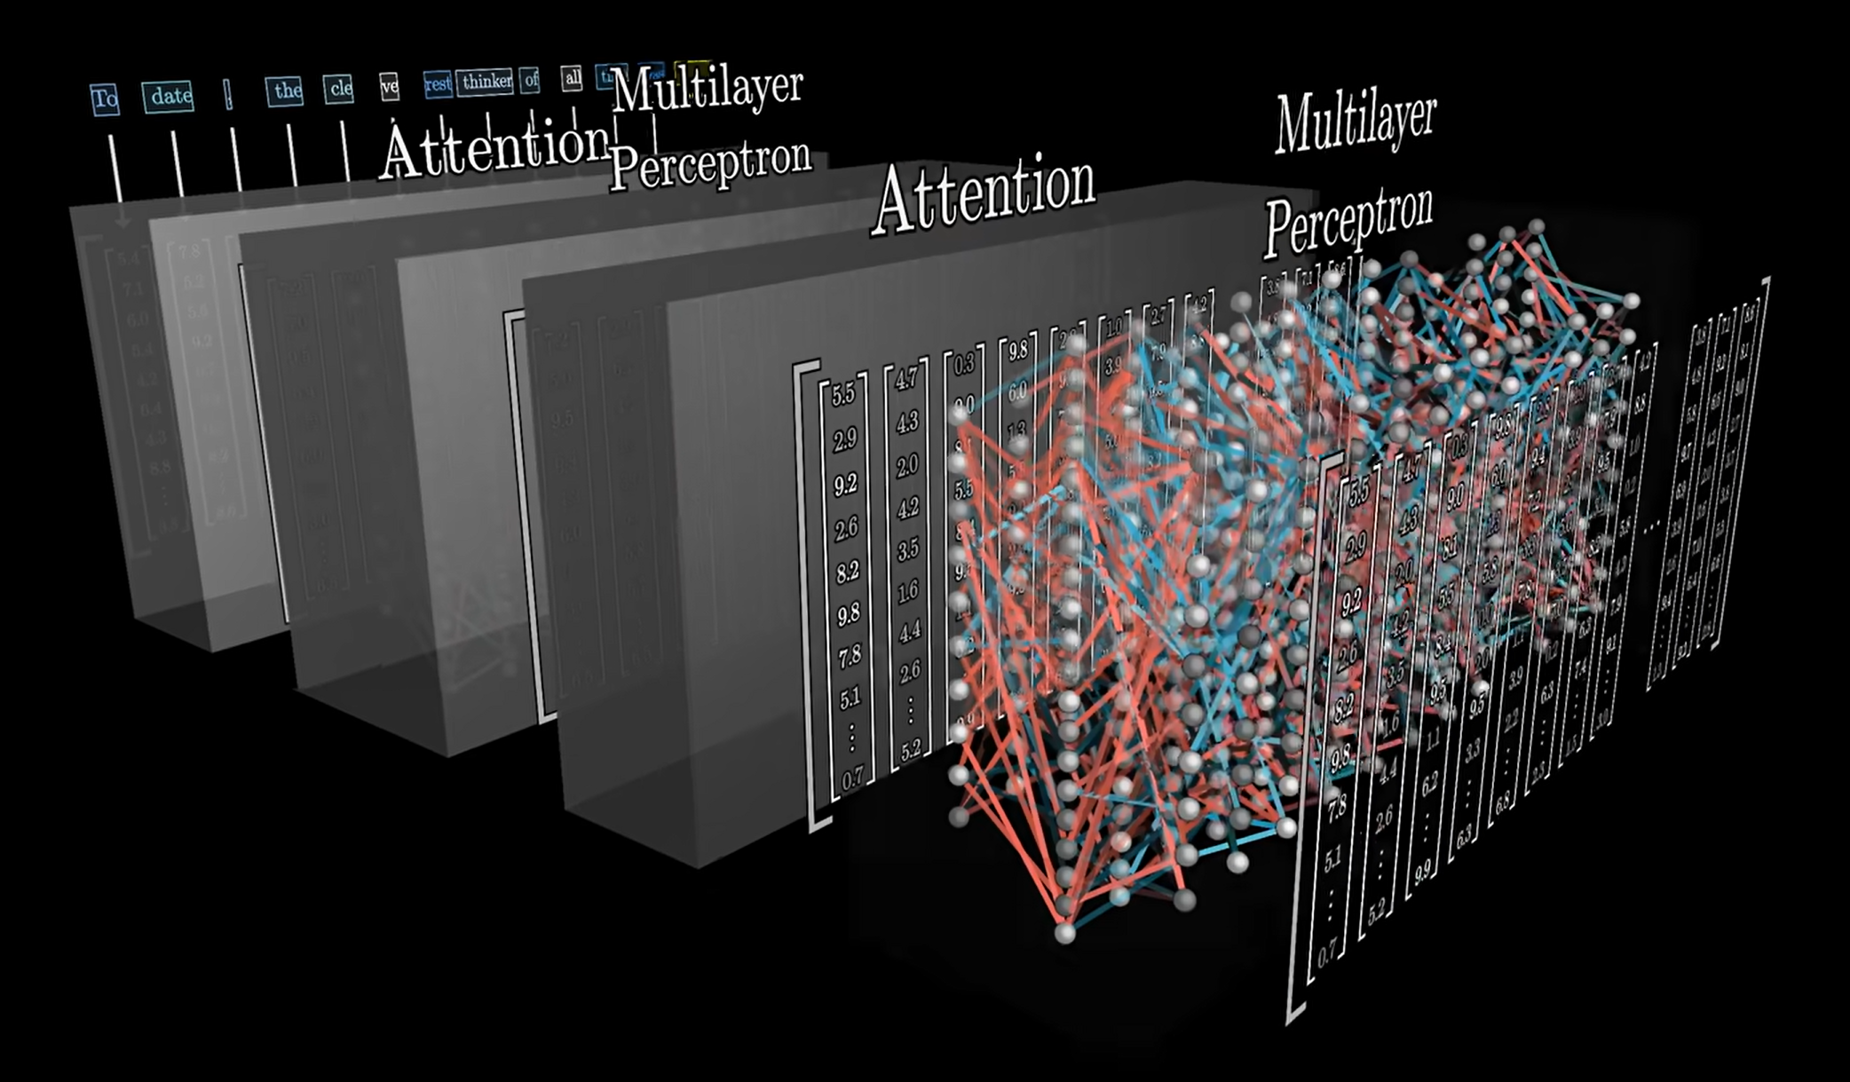
learning to pay attention: transformers
https://youtu.be/wjZofJX0v4M?si=FQfdEoFkcC6yRnfQ

